Slide 1

AVALANCHE PREDICTION USING MACHINE LEARNING
UNDERSTANDING,TESTING AND INTERPRETING SNOW CONDITIONS TO MAKE BETTER AVALANCHE PREDICTIONS

Slide 2
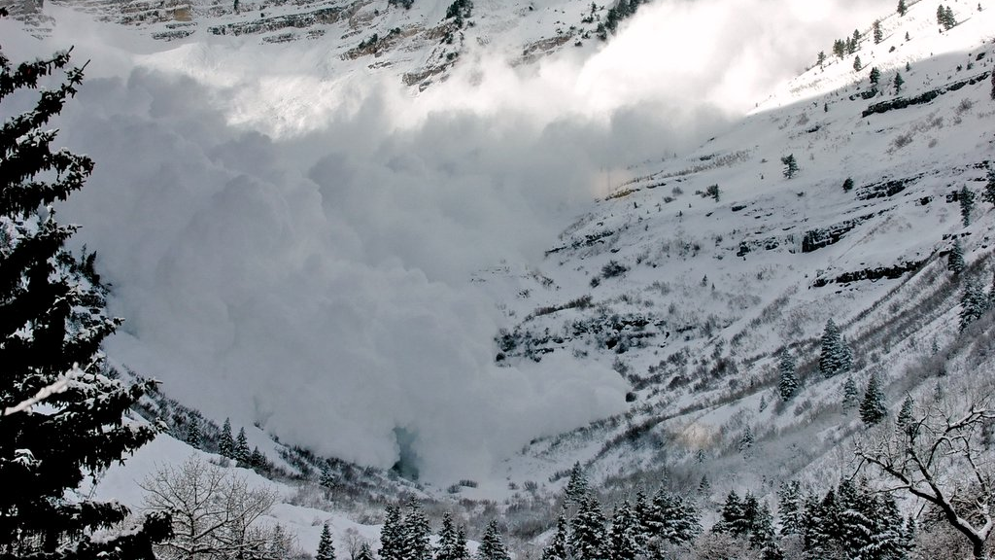
What is Avalanche?
An avalanche is a mass of snow that slides rapidly down an inclined slope, such as a mountainside or the roof of a building.
This Photo by Unknown author is licensed under CC BY.

Slide 3
PARAMETERS AFFECTING AVALANCHE.
SLOPE.
FOREST DENSITY.
SNOW DENSITY.
TEMPERATURE.
WIND.

Slide 4
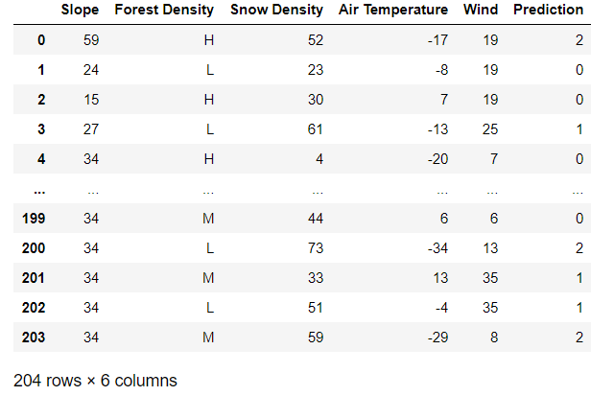
OUR DATASET

Slide 5

ALGORITHM USED:
DECISION TREE CLASSIFIER.

Slide 6
WE HAVE USED VARIOUS DATA VISUALIZATION TECHNIQUES AND THEY ARE:-
Matplotlib: low level, provides lots of freedom.
Pandas Visualization: easy to use interface, built on Matplotlib.
Seaborn: high-level interface, great default styles.

Slide 7
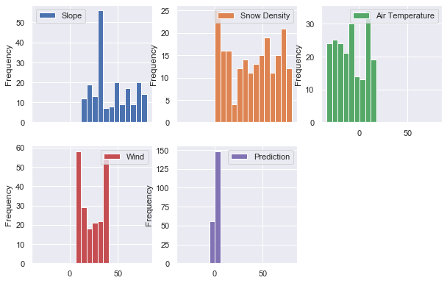
Matplotlib: We have used Histogram.
Each column w.r.t to frequency except categorical using histogram

Slide 8
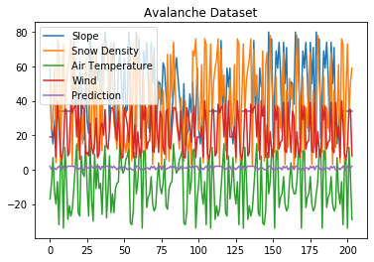
Pandas :We have used Line Chart.
change in slope ,Snow density ,Air temperature ,wind ,Avalanche Prediction in a given interval of time showing by continuous line using LINE CHART.

Slide 9
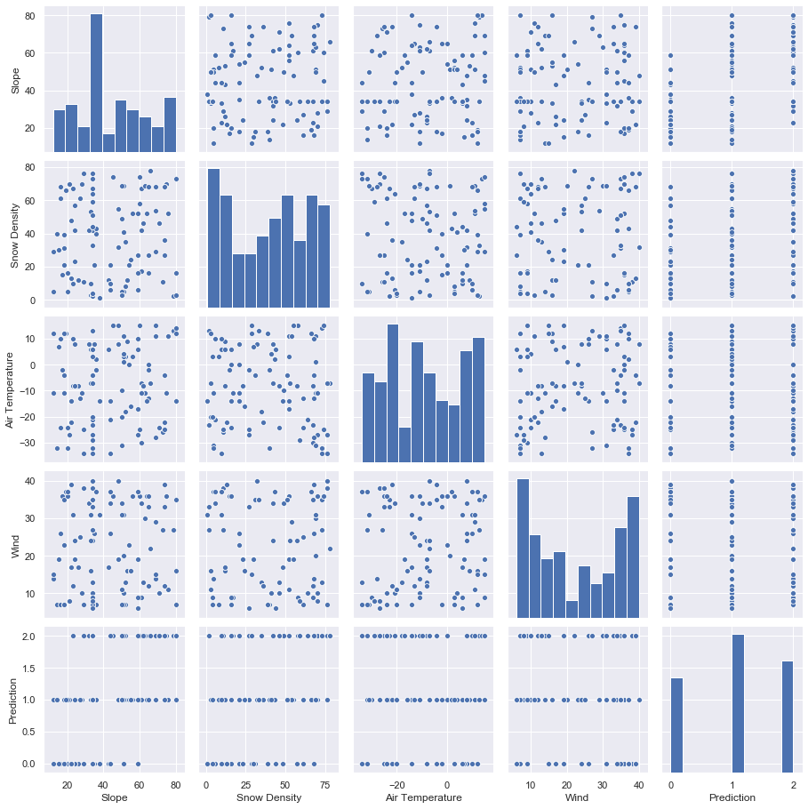
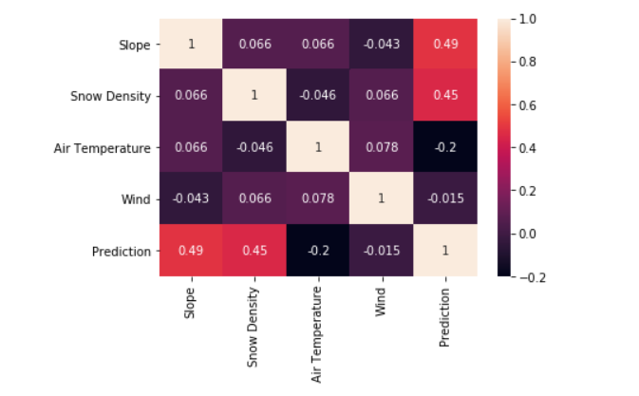
Seaborn: We have used Heat Map ,Pair plot ,Face Grid and Cat plot
1.scatterpoints for all relation between all columns which are numerical
2.Defining correlation factor between each column using heatmap .

Slide 10
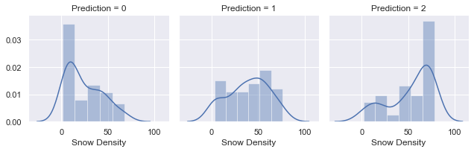
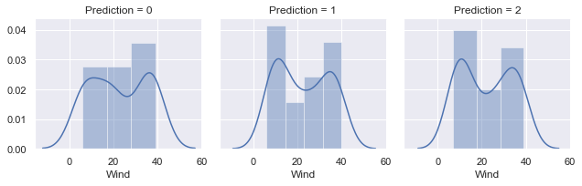
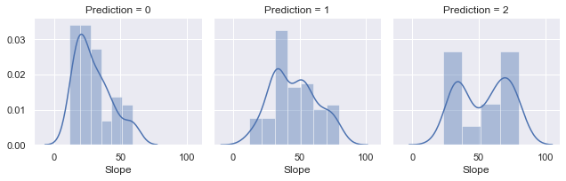
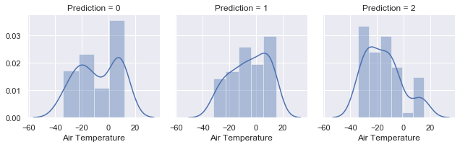
Seaborn: Here we have used faceting to develop a relationship between multiple subplots of numerical values with the avalanche Prediction and here col works as the class/avalanche prediction which is of values 0,1 and 2
#snow Density between 50 t0 60 is most prone
to occurrence of avalanche
#Air temperature between -40 t0 -20 effect the most prone to avalanche occurrence

Slide 11
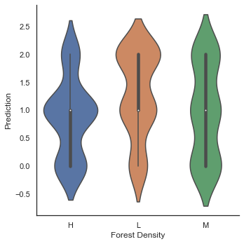
Sea born: cat plot
#Low Forest density causes more
occurrence of Avalanche from cat plot

Slide 12
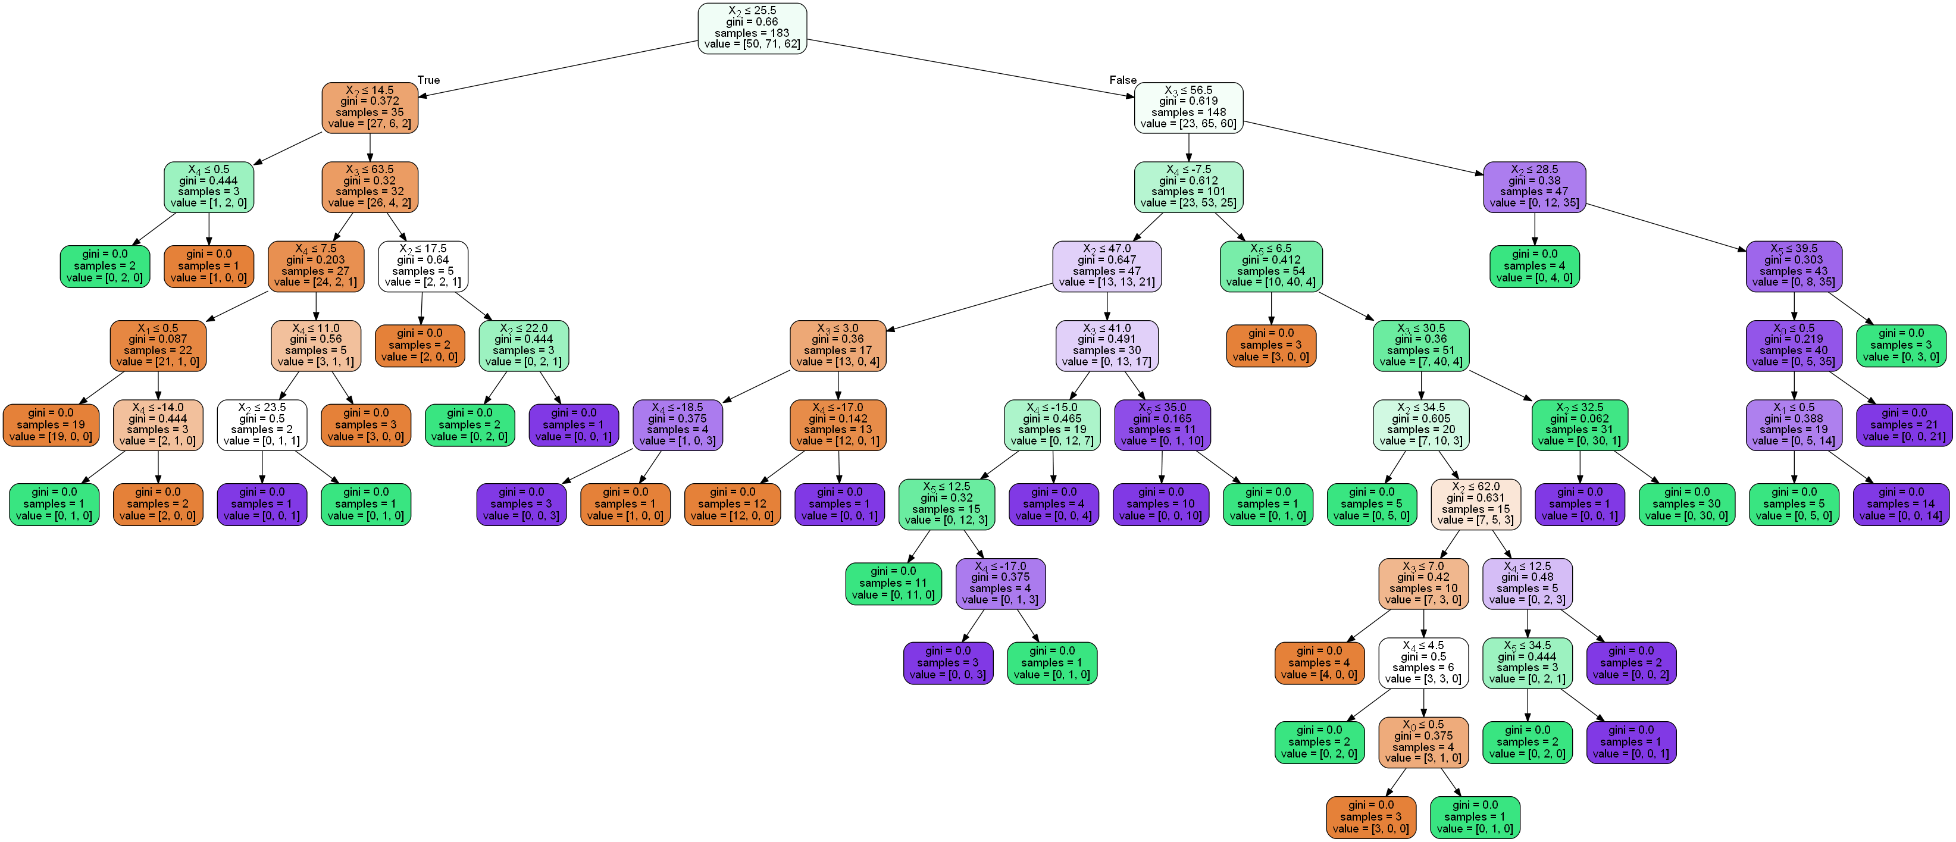
TREE:

Slide 13

Model Evaluation:
We got a good Accuracy.

Slide 14
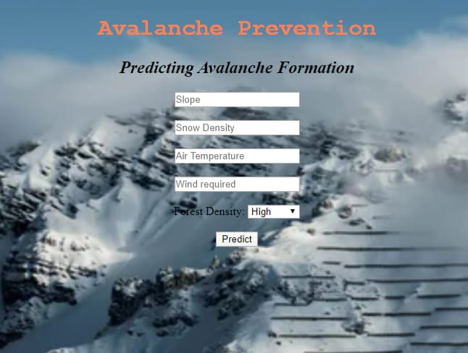
Our user interface

